Slide 1
Alveolar cleft repair
Brett A. Ueeck DMD, MD, FACS

Slide 2
History of Alveolar Repair
Management with bone grafting first described in the early 20th century
Lexer 1908, Drachter 1914
50 years passed without any progress
Mid 1950’s increase in primary bone grafting
1960’s: Increasing evidence primary bone grafting had negative impact on growth
1970’s: Secondary bone grafting introduced by Boyne/Sands and becoming treatment of choice
1980-90’s: Continued research in donor sites, alveolar molding, GPP, growth and overall outcomes
Early 21st Century: rhBMP-2, Stem cells, implants

Slide 3
The Alveolar Defect
Skeletal
Collapse and rotation of the maxillary segments
Cleft in alveolus to piriform rim
Soft Tissue
Lack of attached tissue
Absent gingival anatomy
Oral-nasal fistula
Dental
Missing permanent teeth
Malformed teeth
Supernumerary teeth
Impacted teeth

Slide 4
Goals Of Alveolar Repair
Success Defined By:
1 Grafting must achieve stability of the arch and prevent collapse of the
alveolar segments
2 Grafting must preserve the health of the dentition and maintain bony support of teeth adjacent to the cleft
3 Grafting must restore continuity not only of the alveolus but also the anterior hard palate and the maxilla at the piriform rim (support for alar base)
4 Grafting must support the soft tissue closure of the oronasal fistula
5 Grafting must have adequate volume of bone matrix for erupting teeth in the line of the cleft, and for orthodontic movement of the involved teeth into appropriate “nontorqued” position in the dental arch
6 Grafting must allow for the successful placement of dental implant(s)
Tai et al. J Oral Maxillofac Surg58:1241-1249, 2000

Slide 5
Timing of Repair
Early
Gingivo-perioplasty (with primary lip and/or palate)
Primary bone grafting (abandoned)
Secondary (Traditional)
Age 7-13
Autogenous Bone v rhBMP-2
Tertiary Repair (Late)
After completion of growth
With or without maxillary orthognathic surgery
ICBG with and without rhBMP2
Completion of Repair
Bone and soft tissue repair
Dental implant placement

Slide 6
Early Repair
Gingivoperioplasty
Originally described in 1965 by Skoog
Advanced by Millard, Lathum, Grayson
Closes the alveolus with the lip and/or palate
Combined with dentofacial orthopedic techniques to reduce the cleft width
NAM, Lathum, Tapping, Lip Adhesion
Skoog, T. The use of periosteal flaps in the repair of clefts of the primary palate. Cleft Palate Craniofac. J. 2: 232, 1965.

Slide 7
Gingivoperioplasty
Success
Quantity of bone
Quality of bone
Normal eruption of permanent dentition
Elimination of fistula
Effect on Growth
Dental arch
Maxillary
Facial

Slide 8
Gingivoperioplasty
Success on Bone Formation – Unilateral Clefts
60% of GPP cases did not need secondary grafting
73% of GPP cases did not need secondary grafting
Higher incident of secondary grafting needed in the bilateral cleft cases.
66% need secondary grafts
Santiogo Cleft Palate–Craniofacial Journal, January 1998, Vol. 35 No. 1
Sato, Plast. Reconstr. Surg. 121: 1356, 2008
Santiogo Cleft Palate–Craniofacial Journal, January 1998, Vol. 35 No. 1

Slide 9
Gingivoperioplasty
Success on Fistula Outcome
Overall GPP nearly eliminates fistula
GPP eliminates fistula in every case in one study
Sato, Plast. Reconstr. Surg. 121: 1356, 2008

Slide 10
Gingivoperioplasty
Effect on Growth
Early GPP (Skoog)
Conclusive: Negative Impact
Millard and Lathum
Somewhat inconclusive
Patient follow-up, number of patients, etc
Grayson
No negative growth outcomes
Matic
Potential for growth attenuation

Slide 11
Gingivoperioplasty
Effect on the Dentition – Quite Variable
Negative Outcomes
Positive Outcomes
Missing primary teeth and alteration in eruption
Missing permanent central incisors and higher rate of missing lateral incisors
Malformed teeth
Normalized eruption of primary teeth
No difference in number of missing teeth
Better periodontal health and support for permanent teeth adjacent to the cleft
Stabilized arches

Slide 12
Gingivoperioplasty
Overall
Holds promise for superior alveolar repair
Requires a dedicated and well trained team for best results
Surgeon dependent – technique sensitive

Slide 13
Secondary Bone Grafting
Current preferred method of repair
Timing
Early
Age 7-9: At the time of central incisor eruption
Late
Age 9-11: Canine root 2/3^{rds} formed
Autogenous Donor Sites
Iliac Crest » Rib
Cranium » Tibia
Mandible
rhBMP-2

Slide 14
Secondary Bone Grafting
Donor Sites – Autogenous Bone
Iliac Crest Bone Graft
Boyne 1972 – first introduction of secondary graft
Considered the “Gold Standard”
Mandibular Bone Graft
Bosker 1980
Cranial Bone Graft
Tessier 1982
J.D. Smith 1973

Slide 15
Difference in Graft Donor Sites
ICBG
Mandible
Cranial
Visible scar
Pain
Gait disturbance
Second surgical field
Reliable quantity
Reliable quality
Reliable success
No visible scar
Pain
No gait issues
Single surgical field
Quantity?
Reliable quality
Reliable success
Visible scar
Less pain
No gait issues
Single surgical field
Reliable quantity
Reliable quality
Successful

Slide 16
Secondary Bone Grafting
Considerations…
Impact on Growth
Timing of the graft important
Operative technique?
Selection criteria?
Significant growth retardation – need orthognathic surgery – wait to graft?
Absence of lateral incisor/impacted canine – wait to graft?
Large, unfavorable clefts – 2 stage repair? Single stage with tongue flap?

Slide 17
Secondary Bone Grafting
Further Topics of Consideration
Flap design – degree of periosteal elevation
BCLCP – stage repair?
Splinting post repair
Dressing
PO diet
Antibiotics

Slide 18


Secondary Bone Grafting
Facial Growth Outcomes in the Grafted Patient
Ross (1987) – multicenter comparison of UCLCP grafted patients age 4-10
Marked deficiency in anterior upper-facial height compared to non-grafted patients at age 15
Grafted group age 9-12 showed no difference in non-grafted group.
Confounded study
Brättstrom etal (1992) – comparison of 85 UCLCP pts with primary graft, secondary graft, and no graft
Primary – poor growth
Secondary – after incisors before canine had better growth
Non-grafted patients had the best growth

Slide 19
Secondary Bone Grafting
Facial Growth Outcomes in the Grafted Patient
Semb (1988) – National Center of Logopedics, Oslo, Norway
no difference in growth among UCLCP children grafted between the ages of 8 and 12 compared to non-grafted patients

Slide 20

Effect of Alveolar Bone Grafting in the Mixed Dentition on
Maxillary Growth in Complete Unilateral Cleft Lip and Palate Patients
John Daskalogiannakis, D.D.S., M.Sc. R. Bruce Ross, D.D.S., M.Sc.
The Cleft Palate-Craniofacial Journal: Vol. 34, No. 5, pp. 455–458. 1997

Slide 21
Grafted group: 8.4-12.9yrs (10.3)
Lateral cephs taken pre-grafting and 5-6years post grafting
John Daskalogiannakis, D.D.S., M.Sc. R. Bruce Ross, D.D.S., M.Sc.
The Cleft Palate-Craniofacial Journal: Vol. 34, No. 5, pp. 455–458. 1997

Slide 22
Conclusions
Secondary bone grafting in the UCLCP patient in the age range 8-13yrs of age does not seem to negatively impact the vertical or AP maxillary growth and development.
John Daskalogiannakis, D.D.S., M.Sc. R. Bruce Ross, D.D.S., M.Sc.
The Cleft Palate-Craniofacial Journal: Vol. 34, No. 5, pp. 455–458. 1997

Slide 23
Secondary Bone Grafting
rhBMP-2
Recombinant Human Bone Morphogenic Protein 2
First discovered in 1965 by Dr. Marshall Urist
Now available for clinical use via Medtronic as Infuse® Bone Graft

Slide 24
rhBMP-2
Growth Factor
From the superfamily TGF-B
Several different BMPs induce bone formation
2, 4, 7
BMP-2 acts early in the cascade of events and directly triggers mesenchymal cells to become osteoblasts

Slide 25
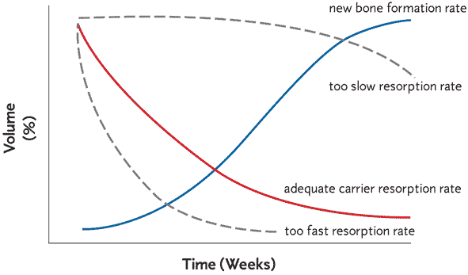
rhBMP-2
The bovine ACS (absorbable collagen sponge) is important for the clinical effects of BMP-2. Binds 95% in 15 minutes. Elutes the BMP-2 for 8-10 days. Fully resorbed in 4-10weeks.
Release kinetics studies show that the ACS releases bound rhBMP-2 in a time period optimal for bone formation

Slide 26
rhBMP-2
Important steps to success
Create appropriate space for rhBMP 2 + ACS
The ACS cannot maintain the space alone
Must ensure access to cells
Periosteum
Adjacent bleeding bone
Proper preparation of the material

Slide 27
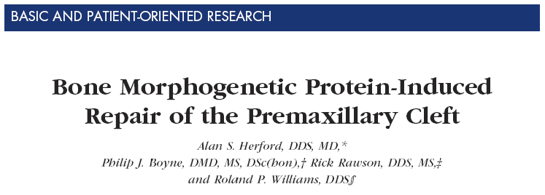
rhBMP-2
The Science in Alveolar Clefts

Slide 28
rhBMP-2
Average Bone Fill
ICBG: 78% bone fill
rhBMP-2: 72% bone fill

Slide 29
rhBMP-2
Benefits
Eliminates need for second (donor) surgical site
Eliminates donor site morbidity
Decreased OR time
Decreased hospital LOS
Decreased health care cost

Slide 30
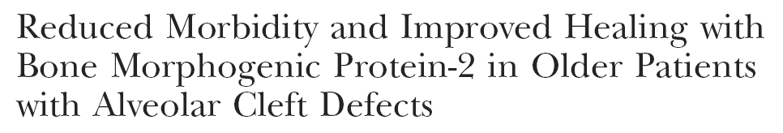
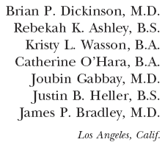
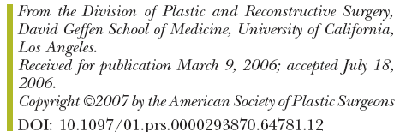
rhBMP-2

Slide 31
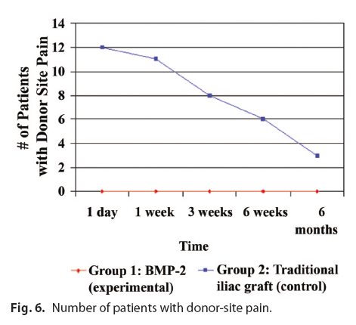
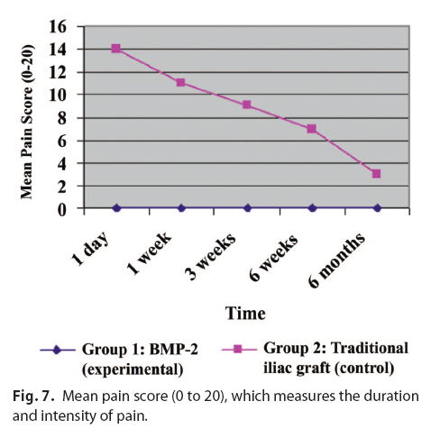
rhBMP-2

Slide 32
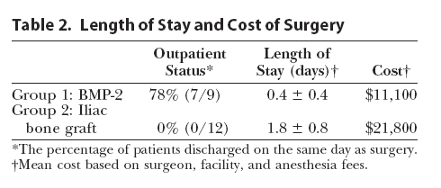
rhBMP-2
Effective Alternative to ICBG
Conclusions are the same as JOMS 2007
Eliminates need for second (donor) surgical site
Eliminates donor site morbidity
Decrease in surgical site complications
Decreased OR time
Decreased hospital LOS
Decreased health care cost

Slide 33
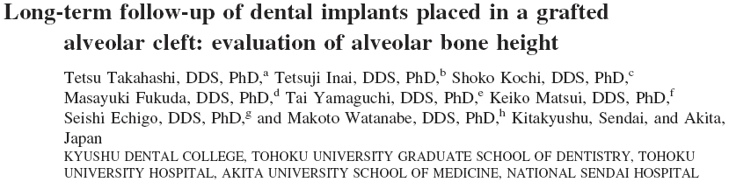
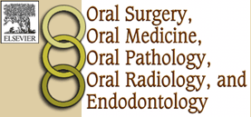
(Oral Surg Oral MedOral Pathol Oral Radiol Endod 2008;105:297-302)
Retrospective study
23 implants placed in 21 patients
5 patients not eligible for inclusion
16 patients (8 male, 8 female)

Slide 34
Secondary Soft Tissue Management
Keratinized grafting in cleft site
Improve peri-implant tissue health
Scar revision
Improve vestibule characteristics
Connective tissue grafting
Improve prosthetic appearance

